Slide 1
Chapter 3: Methodology
MUHAMMAD NADZMI BIN MOHAMED IDZHAM
Dr. Atiqah Sia Binti Abdullah @ Sia Sze Yieng

Slide 2
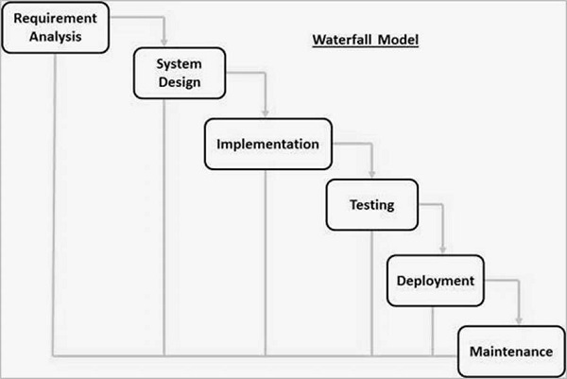
Figure 3.2 Waterfall model
(Source: TutorialsPoints, 2017)

Slide 3
REQUIREMENT ANALYSIS
Objectives | Activities | Deliverables
Determine the potential requirement for the software. | Determine the problem of current Malaysia election data visualization. Determine the similar system that has been implemented by other countries. Based on the similar system, come out with a solution to solve the problem. | Chapter 1 Problem statements Objectives Scope Chapter 2 Literature review Use case diagram

Slide 4
DESIGN
Objectives | Activities | Deliverables
Design the system based on the requirement. | Determine the architecture of the system. Determine the activities of user when interacting with the system. Determine the technologies that will be used. Programming language Platform Framework Design User Interface (UI) mockup for the system. | UI mockup diagram Activity diagram Sequence diagram Robustness diagram

Slide 5
IMPLEMENTATION
Objectives | Activities | Deliverables
Writing actual implementation the designed system. | Coding the basic architecture of the system based on the robustness diagram. Coding the detailed architecture (system logic) based on the sequence diagram. Coding the UI of the system. | Finished prototype system

Slide 6
TESTING
Objectives | Activities | Deliverables
Test the developed system so that it meets the requirements set during requirement analysis phase. | Do unit testing to make sure all function produces expected output. Do system testing to make sure all components of the system fulfills the system requirement. Do verification for the correctness of the data visualization against the actual election data. Improve the User Experience (UX) of the UI if needed. | Finished tested system

